Slide 1
Unit 1
Review of Python and concept of oops

Slide 2
Introduction :-
Python was created by Guido Van Rossum when he was working at CWI (Centrum Wiskunde & Informatica) which is a National Research Institute for Mathematics and Computer Science in Netherlands. The language was released in I991. Python got its name from a BBC comedy series from seventies- “Monty Python‟s Flying Circus”. Python can be used to follow both Procedural approach and Object Oriented approach of programming. It is free to use

Slide 3
We have learnt Python programming language in the 11th class and continue to learn the same language program in class 12th also. We also know that Python is a high level language and we need to have Python interpreter installed in our computer to write and run Python program. Python is also considered as an interpreted language because Python programs are executed by an interpreter.

Slide 4
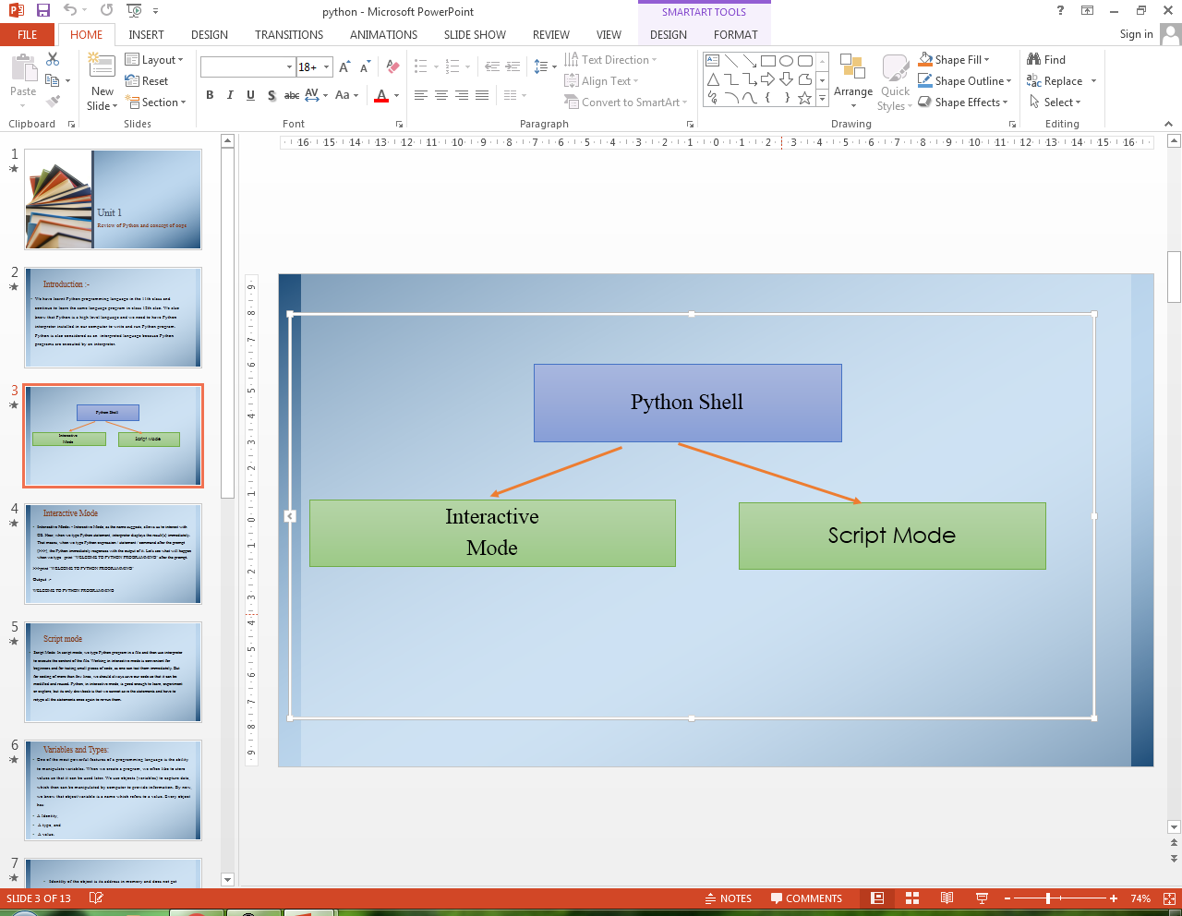

Slide 5
Interactive Mode
Interactive Mode: - Interactive Mode, as the name suggests, allows us to interact with OS. Hear, when we type Python statement, interpreter displays the result(s) immediately. That means, when we type Python expression / statement / command after the prompt (>>>), the Python immediately responses with the output of it. Let's see what will happen when we type print "WELCOME TO PYTHON PROGRAMMING" after the prompt.
>>>print "WELCOME TO PYTHON PROGRAMMING"
Output :-
WELCOME TO PYTHON PROGRAMMING

Slide 6
Script mode
Script Mode: In script mode, we type Python program in a file and then use interpreter to execute the content of the file. Working in interactive mode is convenient for beginners and for testing small pieces of code, as one can test them immediately. But for coding of more than few lines, we should always save our code so that it can be modified and reused. Python, in interactive mode, is good enough to learn, experiment or explore, but its only drawback is that we cannot save the statements and have to retype all the statements once again to re-run them.

Slide 7
Variables and Types:
One of the most powerful features of a programming language is the ability to manipulate variables. When we create a program, we often like to store values so that it can be used later. We use objects (variables) to capture data, which then can be manipulated by computer to provide information. By now, we know that object/variable is a name which refers to a value. Every object has:
A Identity,
A type, and
A value.

Slide 8
Identity of the object is its address in memory and does not get change once it is created. We may know it by typing id (variable)
Type (i.e data type) is a set of values, and the allowable operations on those values. It can be one of the following:

Slide 9
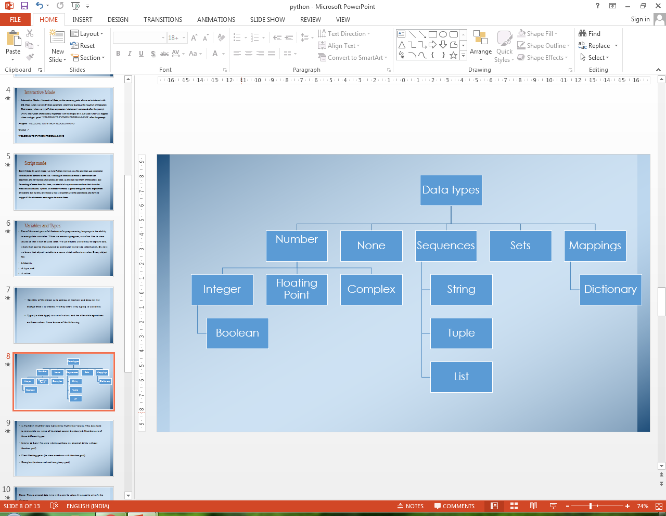

Slide 10
1. Number: Number data type stores Numerical Values. This data type is immutable i.e. value of its object cannot be changed. Numbers are of three different types:
Integer & Long (to store whole numbers i.e. decimal digits without fraction part)(Eg:- 100000, -99, 0, 17)
Float/floating point (to store numbers with fraction part) (Eg:- 12.36 )
Complex (to store real and imaginary part)(Eg:- 1+0j )

Slide 11
None: This is special data type with a single value. It is used to signify the absence of value/false in a situation. It is represented by None.
Sequence: A sequence is an ordered collection of items, indexed by positive integers. It is a combination of mutable (a mutable variable is one, whose value may change) and immutable (an immutable variable is one, whose value may not change) data types. There are three types of sequence data type available in Python, they are Strings, Lists & Tuples.

Slide 12
String- is an ordered sequence of letters/characters. They are enclosed in single quotes (' ') or double quotes ('' "). The quotes are not part of string. They only tell the computer about where the string constant begins and ends. They can have any character or sign, including space in them. These are immutable. A string with length 1 represents a character in Python.(Eg:- ‟ Good Morning”)
Lists: List is also a sequence of values of any type. Values in the list are called elements / items. These are mutable and indexed/ordered. List is enclosed in square brackets ([]).(Eg:- [„spam‟, 20.5,5])
Tuples: Tuples are a sequence of values of any type and are indexed by integers. They are immutable. Tuples are enclosed in ().(Eg:- (4, 2))

Slide 13
Sets: Set is unordered collection of values of any type with no duplicate entry. It is immutable.(Eg:- s = set ([1,2,34]) )
Mapping: This data type is unordered and mutable. Dictionaries fall under Mappings.
Dictionaries: It can store any number of python objects. What they store is a key -value pairs, which are accessed using key. Dictionary is enclosed in curly brackets ({}).(Eg:- d = {1:'a',2:'b',3:'c'} )
Value: Value is any number or a letter or string. To bind value to a variable, we use assignment operator (=). (Eg:- pi = 3.1415)

Slide 14
Keywords - are used to give some special meaning to the interpreter and are used by Python interpreter to recognize the structure of program.
A partial list of keywords in Python 2.7 is
and | del | from | not
while | as | elif | global
Or | With | Assert | else
If | Pass | Yield | Break
Except | Import | Print | class
Exec | In | Raise | continue
Finally | Is | Return | def
For | Lamda | Try

Slide 15
Operators and Operands
Operators are special symbols that represent computation like addition and multiplication. The values that the operator is applied to are called operands. Operators when applied on operands form an expression. Operators are categorized as Arithmetic, Relational, Logical and Assignment. Following is the partial list of operators:
Mathematical/Arithmetic operators: +, -, *, /, %, ** and //.
Relational operators: <=, >, >=, != or <> and ==.
Logical operators: or, and, and not
Assignment Operator: =, +=, -=, *=, /=, %=, **= and //=

Slide 16
Mathematical/Arithmetic Operators
Symbol | Description | Example1 | Example 2
+ | Addition | >>>55+45 100 | >>> „Good‟ + „Morning‟ GoodMorning
- | Subtraction | >>>55-45 10 | >>>30-80 -50
* | Multiplication | >>>55*45 2475 | >>> „Good‟* 3 GoodGoodGood
/ | Division | >>>17/5 3 >>>17/5.0 3.4 | >>>28/3 9
% | Remainder | >>>17%5 2 | >>> 23%2 1
** | Exponentiation | >>>2**3 8 | >>>2**8 256
// | Integer Division | >>>7.0//2 3.0 | >>>3/ / 2 1

Slide 17
Relational Operators
Symbol | Description | Example1 | Example 2
< | Less than | >>>7<10 True >>> 7<5 False >>> 7<10<15 True >>>7<10 and 10<15 True | >>>„Hello‟< ‟Goodbye‟ False >>>'Goodbye'< 'Hello' True
> | Greater than | >>>7>5 True >>>10<10 False | >>>„Hello‟> „Goodbye‟ True >>>'Goodbye'> 'Hello' False
<= | less than equal to | >>> 2<=5 True >>> 7<=4 False | >>>‟Hello”<= ‟Goodbye” False >>>'Goodbye' <= 'Hello' True

Slide 18
Symbol | Description | Example1 | Example 2
>= | greater than equal to | >>>10>=10 True >>>10>=12 False | >>>‟Hello‟>= „Goodbye‟ True >>>'Goodbye' >= 'Hello' False
! =, <> | not equal to | >>>10!=11 True >>>10!=10 False | >>>‟Hello‟!= „HELLO‟ True >>> „Hello‟ != „Hello‟ False
== | equal to | >>>10==10 True >>>10==11 False | >>>„Hello‟ == „Hello‟ True >>>‟Hello‟ == „Good Bye‟ False

Slide 19
Logical Operators
Symbol | Description
or | If any one of the operand is true, then the condition becomes true
and | If both the operands are true, then the condition becomes true.
not | Reverses the state of operand/condition.

Slide 20
Assignment Operators
Assignment Operator combines the effect of arithmetic and assignment operator.

Slide 21
SYMBOL | Description | Example | Explanation
= | Assigned values from right side operands to left variable | >>>x=12* >>>y=‟greetings‟
+= | added and assign back the result to left operand | >>>x+=2 | The operand/ expression/ constant written on RHS of operator is will change the value of x to 14
-= | subtracted and assign back the result to left operand | x-=2 | x will become 10
*= | multiplied and assign back the result to left operand | x*=2 | x will become 24
/= | divided and assign back the result to left operand | x/=2 | x will become 6
%= | taken modulus using two operands and assign the result to left operand | x%=2 | x will become 0
**= | performed exponential (power) calculation on operators and assign value to the left operand | x**=2 | x will become 144
//= | performed floor division on operators and assign value to the left operand | x / /= 2 | x will become 6

Slide 22
Input and Output
Program need to interact with end user to accomplish the desired task, this is done using Input-Output facility. Input means the data entered by user (end user) of the program. In python, raw_input() and input ( ) functions are available for input.
Syntax of raw_input() is:
Variable = raw_input ([prompt])
Syntax for input() is:
Variable = input ([prompt])
Example: x = input ('enter data:')

Slide 23
Print:- This statement is used to display results.
Syntax: print expression/constant/variable
Example: >>> print "Hello"
Hello

Slide 24
Comments:-
As the program gets bigger and more complicated, it becomes difficult to read it and difficult to look at a piece of code and to make out what it is doing by just looking at it. So it is good to add notes to the code, while writing it. These notes are known as comments. In Python, comments start with '#' symbol. Anything written after # in a line is ignored by interpreter. For more than one line comments, we use the following;
Place '#' in front of each line, or
Use triple quoted string. ( """ """)

Slide 25
Functions in Python:- A function is named sequence of statement(s) that performs a computation. It contains line of code(s) that are executed sequentially from top to bottom by Python interpreter. They are the most important building block for any software in Python. For working in script mode, we need to write the Python code in functions and save it in the file having .py extension. Functions can be categorized as belonging to
Modules
Built in
User Defined

Slide 26
Module: A module is a file containing Python definitions (i.e. functions) and statements. Standard library of Python is extended as module(s) to a Programmer. Definitions from the module can be used into code of Program. To use these modules in a program, programmer needs to import the module. Once we import a module, we can reference (use) to any of its functions or variables in our code. There are two ways to import a module in our program, they are
Import
from

Slide 27
Import: It is simplest and most common way to use modules in our code.
Syntax:
import modulename1 [, module name 2, ---------]

Slide 28
Input any number and to find square and square root
import math
x = input("Enter any number")
y = math.sqrt(x)
a = math.pow(x,2)
print "Square Root value=",y
print "square value=",a

Slide 29
output:
Enter any number 25
Square Root value= 5.0
square value= 625.0

Slide 30
From statement: It is used to get a specific function in the code instead of complete file. If we know beforehand which function(s), we will be needing, then we may use 'from'. For modules having large number of functions, it is recommended to use from instead of import.
Syntax >>> from modulename import functionname [, functionname…..]
from modulename import *
will import everything from the file.

Slide 31
Input any number and to find square and square root.
Code:-
from math import sqrt,pow
x=input("Enter any number")
y=sqrt(x) #without using math
a=pow(x,2) #without using math
print "Square Root value =",y
print "square value =",a

Slide 32
Output :-
Enter any number 100
Square Root value = 10.0
square value = 10000.0
The functions available in math module are:
ceil() floor() fabs() exp() log() log10() pow() sqrt() cos() sin() tan() degrees() radians() Some functions from random module are: random() randint() uniform() randrange()

Slide 33
Built in Function:
Built in functions are the function(s) that are built into Python and can be accessed by Programmer. These are always available and for using them, we don't have to import any module (file). Python has a small set of built-in functions as most of the functions have been partitioned to modules. This was done to keep core language precise.
abs() max() min() bin() divmod() len() range() round() bool() chr() float() int() long() str( ) type( ) id( ) tuple( )

Slide 34
User Defined Functions:- In Python, it is also possible for programmer to write their own function(s). These functions can then be combined to form module which can be used in other programs by importing them.
To define a function, keyword 'def' is used. After the keyword comes an identifier i.e. name of the function, followed by parenthesized list of parameters and the colon which ends up the line, followed by the block of statement(s) that are the part of function.

Slide 35
Syntax: -
def NAME ([PARAMETER1, PARAMETER2, …..]):
#Square brackets include optional part of statement
statement(s)

Slide 36
To find simple interest using function.
Code :-
def SI(P,R,T):
return(P*R*T)
Output:
>>> SI(1000,2,10)
20000

Slide 37
Parameters and Arguments

Slide 38
Parameters
the value(s) provided in the parenthesis when we write function header. These are the values required by function to work. If there is more than one value required by the function to work on, then, all of them will be listed in parameter list separated by comma.
Example: def SI (P,R,T)

Slide 39
Arguments
The value(s) provided in function call/invoke statement. List of arguments should be supplied in same way as parameters are listed. Bounding of parameters to arguments is done 1:1, and so there should be same number and type of arguments as mentioned in parameter list.
Example:
Arguments in function call
>>> SI (1000,2,10)
1000,2,10 are arguments.
An argument can be constant, variable, or expression.

Slide 40
Write the output from the following function:-
def SI(p , r=10,t=5):
return(p*r*t/100)
if we use following call statement:
SI(10000)
SI(20000,5)
SI(50000,7,3)

Slide 41
Output
>>> SI(10000)
5000
>>> SI(20000,5)
5000
>>> SI(50000,7,3) 10500

Slide 42
Flow of Execution
Execution always begins at the first statement of the program. Statements are executed one after the other from top to bottom. Further, the way of execution of the program shall be categorized into three ways;
(i) sequence statements,
(ii) selection statements, and
(iii) iteration or looping statements.

Slide 43
Sequence statements:- In this program, all the instructions are executed one after another
Example: Program to find area of the circle.
r = input("enter any radius of the circle")
a = 3.14*r*r
print "Area=",a
output: enter any radius of the circle 7
Area = 153.86
In the above program, all three statements are executed one after another

Slide 44
Selective Statements:- In this program, some portion of the program is executed based upon the conditional test. If the conditional test is true, compiler will execute some part of the program, otherwise it will execute other part of the program. This is implemented in python using if statement.

Slide 45
Syntax:-
if (condition):
statements
else
statements

Slide 46
if (condition):
statements
elif (condition):
statements
else:
statements

Slide 47
Example: 1. Program to find the simple interest based upon number of years. If number of years is more than 12 rate of interest is 10 otherwise 15
Code:-
p = input("Enter any principle amount")
t = input("Enter any time")
if (t>10):
si = p*t*10/100
else:
si = p*t*15/100 print "Simple Interest = ",si

Slide 48
output:-
Enter any principle amount 3000
Enter any time12
Simple Interest = 3600

Slide 49
2. Write a program to input any choice and to implement the following.
Choice Find
1. Area of square
2. Area of rectangle
3. Area of triangle

Slide 50
Code:-
c = input ("Enter any Choice")
if(c==1):
s = input("enter any side of the square")
a = s*s
print"Area = ",a
elif(c==2):
l = input("enter length")
b = input("enter breadth")
a = l*b
print"Area = ",a

Slide 51
elif(c==3):
x = input("enter first side of triangle")
y = input("enter second side of triangle")
z = input("enter third side of triangle")
s = (x+y+z)/2
A = ((s-x)*(s-y)*(s-z))**0.5
print"Area=",A
else:
print "Wrong input"

Slide 52
Output:-
Enter any Choice 2
enter length 4
enter breadth 6
Area = 24

Slide 53
Iterative statements:- In some programs, certain set of statements are executed again and again based upon conditional test. i.e executed more than one time. This type of execution is called looping or iteration. Looping statement in python is implemented by using 'for' and 'while' statement.
Syntax:-
(for loop)
for variable in range(start,stop+1,step):
statements

Slide 54
Syntax: (while loop)
while (condition):
Statements

Slide 55
1. Write a program to input any number and to print all natural numbers up to given number.
Code :-
n = input("enter any number")
for i in range(1,n+1):
print i,
Output:
enter any number 10
1 2 3 4 5 6 7 8 9 10

Slide 56
Write a program to input any number and to find sum of all natural numbers up to given number.
Code :-
n = input("Enter any number")
sum= 0
for i in range(1,n+1):
sum = sum+i
print "sum=",sum
Output:
Enter any number 5
sum = 15

Slide 57
Write a program to input any number and to find reverse of that number
Code :-
n = input("Enter any number")
r = 0
while(n>0):
r = r*10+n%10
n = n/10
print "reverse number is", r
Output: >>> Enter any number345 reverse number is 543

Slide 58
String:
In python, consecutive sequence of characters is known as a string. An individual character in a string is accessed using a subscript (index). The subscript should always be an integer (positive or negative) and starts from 0. A literal/constant value to a string can be assigned using a single quotes, double quotes or triple quotes. Strings are immutable i.e. the contents of the string cannot be changed after it is created.

Slide 59
Strings Operations:
+ (Concatenation)
* (Repetition )
in (Membership)
not in range (start, stop[,step])
slice[n:m]

Slide 60
Write the output from the following code:
A = 'Global'
B = 'warming'
print A+B
Ans: Globalwarming

Slide 61
A = 'Global'
print 3*A
Ans:
'GlobalGlobalGlobal'

Slide 62
A='Global'
'o' in A
Ans: True

Slide 63
A='Global‘
'g' in A
Ans: False

Slide 64
A='Global'
'o' not in A
Ans: False

Slide 65
A='Global‘
'g' not in A
Ans: True

Slide 66
String methods & built in functions:
len() capitalize() find(sub[,start[, end]]) isalnum() isalpha()
isdigit() lower() islower() isupper() upper() lstrip() rstrip() isspace() istitle()
replace(old,new) join () swapcase() partition(sep) split([sep[,maxsplit]])

Slide 67
>>> s='Congratulations'
>>> len(s)
15

Slide 68
>>> s.capitalize() 'Congratulations'
>>> s.find('al')
-1

Slide 69
s.find('la')
8

Slide 70
s[0].isalnum()
True
s[0].isalpha()
True
s[0].isdigit()
False
s.lower()
'congratulations'

Slide 71
s.upper()
'CONGRATULATIONS‘
s[0].isupper()
True
s[1].isupper()
False
s.replace('a','@')
'Congr@tul@tions'

Slide 72
s.isspace()
False
s.swapcase()
'cONGRATULATIONS‘
s.partition('a')
('Congr', 'a', 'tulations')
s.split('ra',4)
['Cong', 'tulations']

Slide 73
s.split('a')
['Congr', 'tul', 'tions']
>>> a=' abc '
>>> a.lstrip()
'abc ‘
>>> a.rstrip()
' abc'

Slide 74
Write a program to input any string and count number of uppercase and lowercase letters.

Slide 75
s=raw_input("Enter any String")
rint s
u=0
l=0
i=0
while i<len(s):
if (s[i].islower()==True):
l+=1
if (s[i].isupper()==True):
u+=1
i+=1
print "Total upper case letters :", u
print "Total Lower case letters :", l

Slide 76
Output:
Enter any String Python PROG
Python PROG
Total upper case letters: 5
Total Lower case letters: 5

Slide 77
Write the output from the following code:
s = 'Indian FESTIVALS‘
i = 0
while i<len(s):
if (s[i].islower()):
print s[i].upper(),
if (s[i].isupper()):
print s[i].lower(),
i + =1
Ans: i N D I A N f e s t i v a l s

Slide 78
List:
Like a string, list is a sequence of values. In a string, the values are characters, whereas in a list, they can be of any type. The values in the list are called elements or items or members. It is an ordered set of values enclosed in square brackets [ ]. Values in the list can be modified, i.e. it is mutable. As it is set of values, we can use index in square brackets [ ] to identify a value belonging to it.

Slide 79
List Slices: Slice operator works on list. This is used to display more than one selected values on the output screen. Slices are treated as boundaries and the result will contain all the elements between boundaries.

Slide 80
Syntax:
Seq = L [start: stop: step]
Where start, stop & step - all three are optional. If you omit first index, slice starts from '0' and omitting of stop will take it to end. Default value of step is 1.

Slide 81
Example:
L=[10,20,30,40,50] >>> L1=L[2:4] >>> print L1 [30, 40]

Slide 82
List Methods:
append() extend () pop() del() remove() insert() sort() reverse() len()

Slide 83
Example:
L=[500,1000,1500,2000]
>>> L.append(2500)
>>> print L
[500, 1000, 1500, 2000, 2500]

Slide 84
L1=[3000,3500]
>>> L.extend(L1)
print L
[500, 1000, 1500, 2000, 2500, 3000, 3500]
>>> L.pop() 3500
>>> L.pop(3) 2000
>>> print L
[500, 1000, 1500, 2500, 3000]
>>> del L[2]
>>> print L
[500, 1000, 2500, 3000]

Slide 85
L.remove(1000)
>>> print L
[500, 2500, 3000]
>>> L.insert(3,3500)
>>> print L
[500, 2500, 3000, 3500]
>>> L.reverse()
>>> print L
[3500, 3000, 2500, 500]

Slide 86
L.sort()
>>> print L
[500, 2500, 3000, 3500]
>>> print len(L)
4
Note: Operator + & * can also be applied on the lists. + is used to concatenate the two lists and * is used to repeat the list given number of times.

Slide 87
Example:
>>> l=[10,20,30]
>>> m=[40,50]
>>> l=l + m
>>> print l
[10, 20, 30, 40, 50]
>>> b=m*3
>>> print b
[40, 50, 40, 50, 40, 50]

Slide 88
Dictionaries:
A dictionary is like a list, but more in general. In a list, index value is an integer, while in a dictionary index value can be any other data type and are called keys. The key will be used as a string as it is easy to recall. A dictionary is an extremely useful data storage construct for storing and retrieving all key value pairs, where each element is accessed (or indexed) by a unique key. However, dictionary keys are not in sequences and hence maintain no left-to-right order

Slide 89
Key-value pair:
We can refer to a dictionary as a mapping between a set of indices (which are called keys) and a set of values. Each key maps a value. The association of a key and a value is called a key-value pair.

Slide 90
Syntax:
my_dict = {'key1': 'value1','key2': 'value2','key3': 'value3'…
'keyn': 'valuen'}
Note:Dictionary is created by using curly brackets(ie. {}).

Slide 91
Dictionary methods:
cmp( ) len( ) clear( ) get() has_key( ) items( ) keys() values() update() dict()

Slide 92
Example:
>>> month=dict()
>>> print month
{}
>>> month["one"]="January"
>>> month["two"]="Feb"
>>> print month
{'two': 'Feb', 'one': 'January'}
>>> len(month)
2

Slide 93
>>> month.get("one")
'January'
>>> month.get("one","feb")
'January'
>>> month.keys()
['two', 'one']
>>> month.has_key("one")
True

Slide 94
>>> month.has_key("three")
False
>>> month.items()
[('two', 'Feb'), ('one', 'January')]
>>> month.values()
['Feb', 'January']
>>> m=month
>>> cmp(month,m)
0

Slide 95
>>> n=dict()
>>> cmp(m,n)
1
>>> cmp(n,m)
-1
>>> m.clear()
>>> print m
{}

Slide 96
Tuples:
A tuple is a sequence of values, which can be of any type and they are indexed by integer. Tuples are just like list, but we can't change values of tuples in place. Thus tuples are immutable. The index value of tuple starts from 0. A tuple consists of a number of values separated by commas. For example: >>> T=10, 20, 30, 40 >>> print
But in the result, same tuple is printed using parentheses. To create a tuple with single element, we have to use final comma. A value within the parenthesis is not tuple.T (10, 20, 30, 40)

Slide 97
Tuple Slices:
Slice operator works on Tuple also. This is used to display more than one selected value on the output screen. Slices are treated as boundaries and the result will contain all the elements between boundaries.

Slide 98
Syntax:
Seq = T [start: stop: step]
Where start, stop & step - all three are optional. If we omit first index, slice starts from '0'. On omitting stop, slice will take it to end. Default value of step is 1.

Slide 99
Example:
>>> T=(10,20,30,40,50)
>>> T1=T[2:4]
>>> print T1
(30, 40)
In the above example, starting position is 2 and ending position is 3(4-1), so the selected elements are 30 & 40.

Slide 100
Tuple functions:
cmp( ) len( ) max( ) min( ) tuple( )

Slide 101
Example:
>>> T=tuple()
>>> print T
()
>>> T=["mon","tue","wed","thu","fri","sat","sun"]
>>> print T
['mon', 'tue', 'wed', 'thu', 'fri', 'sat', 'sun']
>>> len(T)
7

Slide 102
>>> min(T)
'fri'
>>> max(T)
'wed'
>>> T1=T
>>> T2=(10,20,30)
>>> cmp(T,T1)
0
>>> cmp(T2,T1)
1
>>> cmp(T1,T2)
-1

Slide 103
LET'S REVISE
Interactive Mode: Interactive Mode, as the name suggests, allows us to interact with OS.
Script Mode: In script mode, we type Python program in a file and then use interpreter to execute the
content of the file.
Number: Number data type stores Numerical Values.

Slide 104
Sequence: A sequence is an ordered collection of items, indexed by positive integers.
Arithmetic operators: +, -, *, /, %, ** and //.
Relational operators: <, <=, >, >=, != or <> and ==.
Logical operators: or, and, and not
Assignment Operator: =, +=, -=, *=, /=, %=, **= and //=

Slide 105
Functions in Python: A function is named sequence of statement(s) that performs a computation.
Module: A module is a file containing Python definitions (i.e. functions) and statements. Standard library
of Python is extended as module(s) to a Programmer.
String: In python, consecutive sequence of characters is known as a string. An individual character in a
string is accessed using a subscript (index).
List: Like a string, list is a sequence of values. List can be of any type.
Dictionaries: A dictionary is like a list, but more in general. In a list, index value is an integer, while in a
dictionary index value can be any other data type and are called keys.
Tuples: A tuple is a sequence of values, which can be of any type and they are indexed by integer.

